Slide 1
Team Name : NAV_Unique
Project Title : Homy Shopping App
SHOP AT HOME WITH EASE
Track : Augmented Reality
Team Members : Shekhina Mary J
Vijaraghavan D
Zaid Aasim M
Vishnuvardhan N L
Tejas A T M

Slide 2
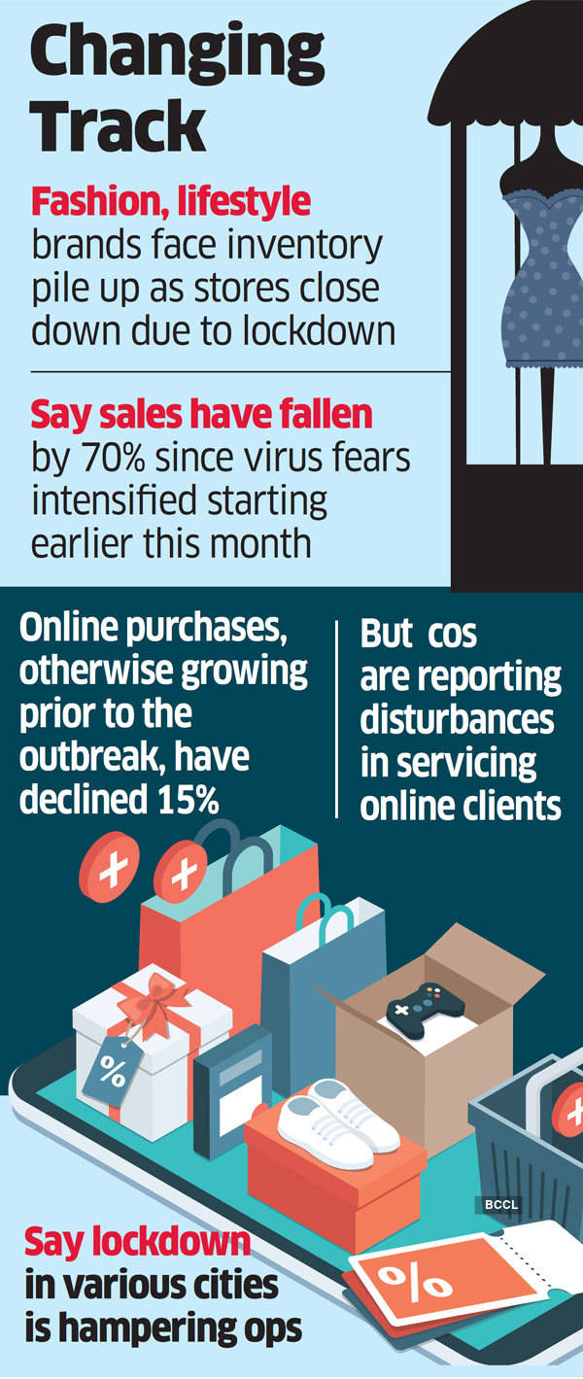
PROBLEM AND RESEARCH
Amidst this pandemic, people feel uncomfortable to go out and shop, as there is a high threat of getting infected.
As a result the textile sector of our country is heavily affected and the stock prices of this particular sector has radically fallen.
So as a team we want to bring a change in this and provide an opportunity to the user to experience the same traditional shopping experience i.e. Going to the store, trying various different outfits and picking the one you like best according to your size. Well this can all be done online using 3d body scanners and Augmented Reality.

Slide 3

IDEA
So basically our idea is to use Augmented Reality to give our customers a virtual environment of the shop where they can roam around and pick the outfits they like, With the help of a 3D body scanner, their body measurement would be taken
Then using 3D rendering, we would render a 3D image of the customer in the outfit they choose, as a result - they would be able to view how they look in that particular outfit they chose.
If they like the outfit they chose, our application would take them to the billing section or if they want to continue their purchase, then they would be directed back to the virtual shop.
Our advertisement would explain the idea clearly
https://youtu.be/ZfD8rP77d2Q

Slide 4
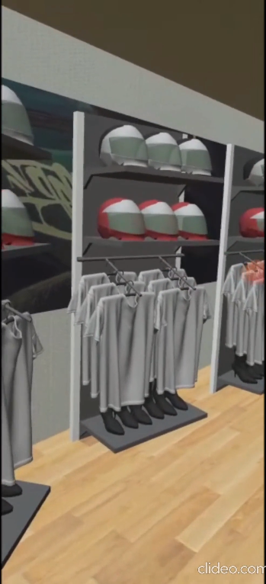
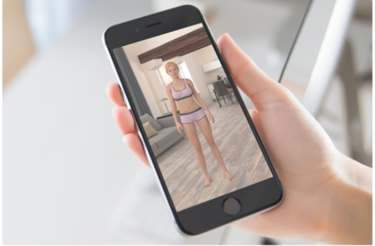
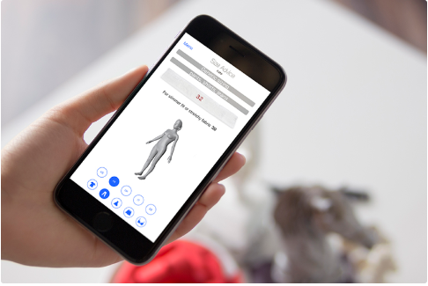
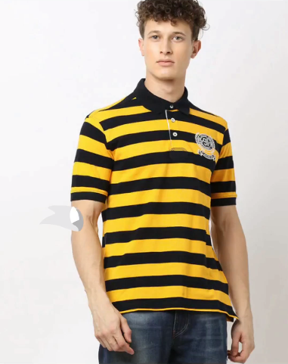
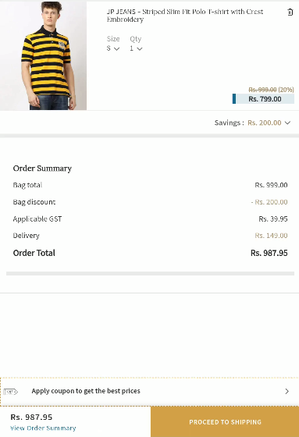
SCAN YOUR BODY
YOUR SIZE WILL BE DISPLAYED ON THE SCREEN
Using AR we are the store is at your house
Select your preferred oufit by clicking on it
AN AUGMENTED IMAGE OF YOU WILL BE CREATED WEARING THE CLOTHES YOU CHOSE
BILLING SECTION

Slide 5

Target audience
Our target customers are everyone who love to shop. Particularly for those, who's marriages and other functions which has been fixed amidst this pandemic. Let us take an example of a marriage function, dress for the groom is yet to be designed, and most of the marriages nowadays are happening in a very small scale, so we suggest our app to take the perfect measurement of the groom and match his preferred outfit according to his size.

Slide 6
COST TO SELL THE PRODUCT
If monthly active users is below 25000 it’s free .
If 100000 users $ 4.00 (for 1000)
If 125000 users $ 3.20 (for 1000)
If 410000 users $ 2.40 (for 1000)
Cost per 1000 decreases with increase in users.

Slide 7
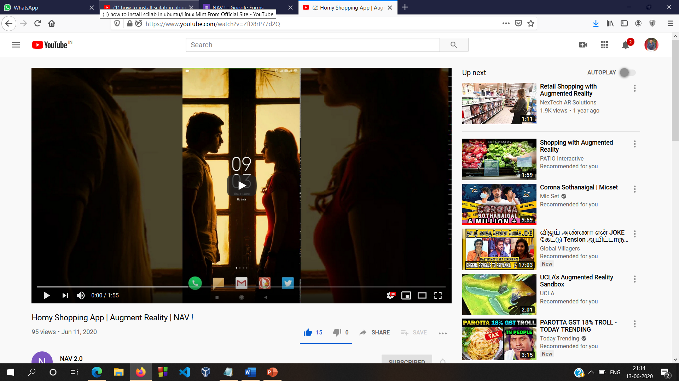
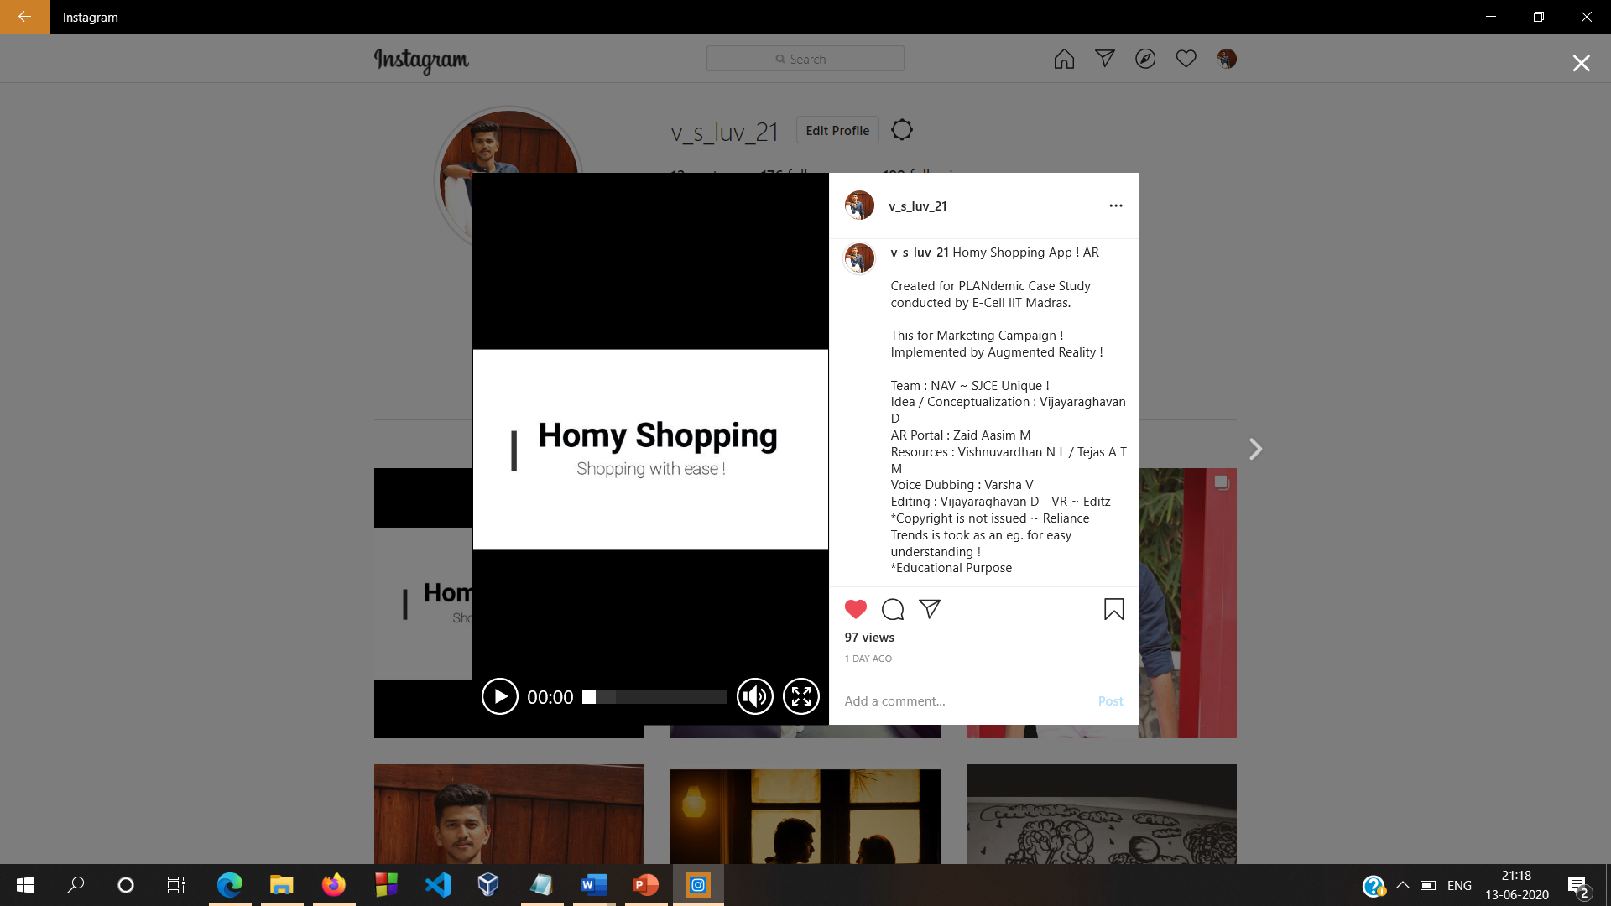
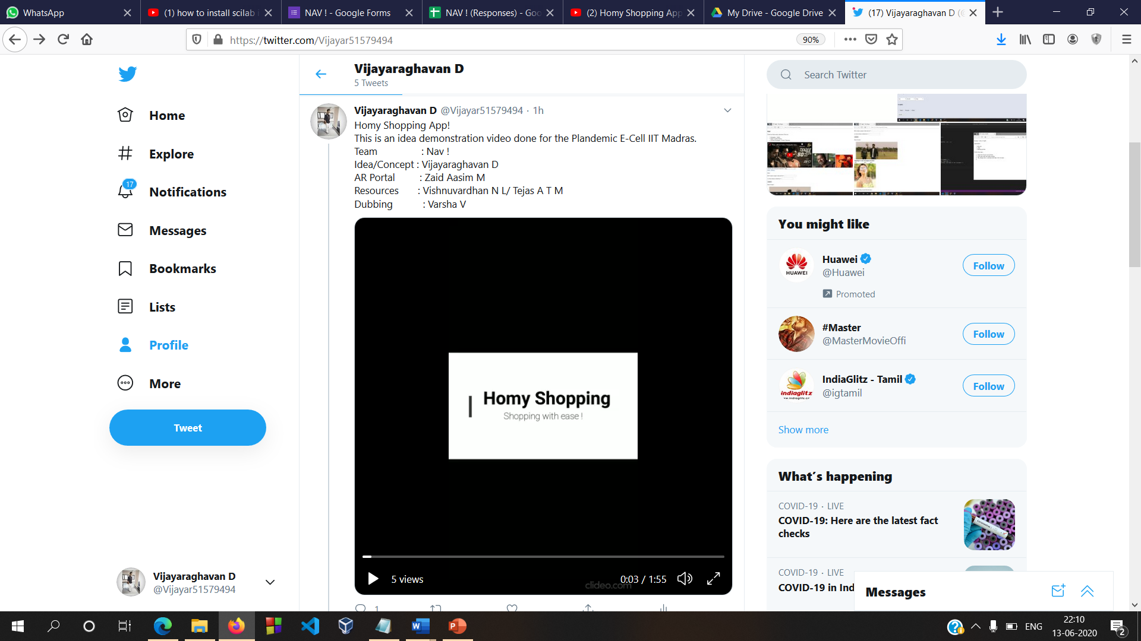
Executing the campaign
We executed our campaign in different platforms : YouTube, Instagram, Twitter, Whatsapp, etc.
YouTube : https://youtu.be/ZfD8rP77d2Q
Instagram : https://www.instagram.com/tv/CBT1Yw_lPjC/?utm_source=ig_web_copy_link
Twitter : https://twitter.com/Vijayar51579494/status/1271819069008703489?s=08

Slide 8

Unique !
Source code(Apk) : Github - https://github.com/321mzaasim/AR-Shopping

